Slide 1
Create your own one-page RPG
Nina NAVAZIO | Deepti Vaidyanathan
Thanks to: William ASSAF
Checklist
Grab worksheets (should be 2 pages)
Or go to: tinyurl.com/CreateYourOwnOnePageRPG > Worksheets
Answer at your table: If your favorite game existed, what would it be like?
Notes:
<deepti> Good afternoon everyone! While you’re all coming in, make sure you grab some worksheets on here or from the link, and answer in chat or in real life: If every game existed, what would your favorite game look like?
Welcome to Create your own one-page RPG, a design thinking workshop. My name is Deepti Vaidyanathan, I’m a software engineer in Azure Compute, and I’ve been playing RPGs since college haven’t really stopped since! I’m joined by my Cohost, Nina, and our wonderful friend William who helped us create this workshop last year for PAX West! Nina?...
Awesome, we’re ready to really get started now. Going over the checklist, please make sure that you have the worksheets you need, there should be two pieces of paper, and they should say Part 1, 2, and 3 on them. If you don’t have a physical copy, you can follow along with a copy from our Github at tinyurl.com/CreateYourOwnOnePageRPG > Worksheets.

Slide 2
Overview
By the end of this workshop, you will have filled out both worksheets, or have plans to fill it all out and be inspired to continue creating and playing RPGs.
PROLOGUE Why make a tabletop role-playing game?
Part 1 Empathize + define: foundations (+ workshop time)
Part 2 Ideate: turn actions into gameplay (+ workshop time)
Part 3 Prototype: writing THE rules (+ workshop time)
Finale This is all design thinking!
Epilogue Next steps for your RPG & Q&A
Notes:
<deepti> So, just to set expectations, by the end of this workshop you will have filled out both worksheets you’ve got right now, or at least have plans to fill it out all, and you’ll be inspired to continue working on, creating, and playing RPGs.
I’ll also add that if you feel like writing on your worksheets at any time, like jumping ahead or you’re inspired by something and you really need to write it down, PLEASE WRITE IT DOWN! We will not be offended if we see you writing on your papers instead of listening to us. Just keep in mind that we’ll be mainly focusing on each part in order, with dedicated workshop time for each.
So we’ll start in the prologue, where we’ll go over why you should even consider making a table-top roleplaying game in the first place. Then we’ll focus on Part 1 of the worksheet, which is empathizing and defining the game. You’ll then get about 10 minutes of workshop time to fill out that first page of the worksheet, during which all of us will be floating around, checking chat, etc. to answer questions and help you brainstorm. Next, we’ll go over ideation and how to turn your actions into gameplay. This is one of the more difficult sections of the workshop, and we’ll definitely be available for help during the workshop time. Finally, we’ll talk about prototyping and writing the rules. You’ll also get workshop time for this. At the end of the presentation, we’ll talk about how all that you’ve done today is design thinking, what a fun gotcha moment, and then we’ll go over what you can do next with your worksheets or RPG ideas.

Slide 3
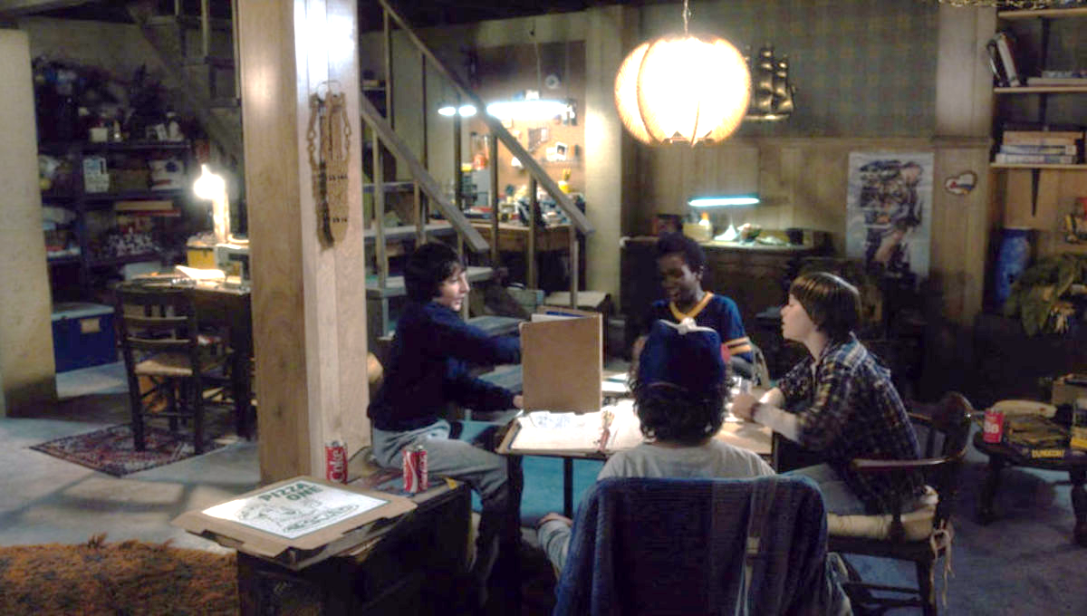
What is a tabletop role-playing game (TTRPG)?
CREATE YOUR OWN RPG
Stranger Things (season 1, episode 1)
Legal Stuff: This content and group is not affiliated with, endorsed, sponsored, or specifically approved by Wizards of the Coast LLC. Dungeons & Dragons® is a trademark[s] of Wizards of the Coast. For more information about Wizards of the Coast or any of Wizards' trademarks or other intellectual property, please visit their website at (www.wizards.com).
Notes:
<nina>
So, what is a TTRPG? I think if you're in this presentation you're probably familiar with the concept of a tabletop roleplaying game like Dungeons and Dragons.
That’s the thing you saw on Stranger Things or Critical Role or Big Bang Theory or Community.
Here characters from Netflix's Stranger Things playing Dungeons and Dragons, and you can see the two roles at the table: the Players,
<click>
and the Main Storyteller
<click>
(also known as the Game Master or Dungeon Master or Main Storyteller, the terminology differs and is up to you.)
Everyone here is playing the game, but the Main Storyteller knows a lot more than the other players about the events that will be unfolding—they’ve probably prepared a series of scenes, quests, and enemies for the player to experience and meet.
Now, the one-page game we’re discussing today could have a similar setup, or something different– like having no Main Storyteller at all. That’s totally up to you, but what’s generally the same across all roleplaying games—whether they’re D&D 5e or a onepage RPG, is that all the players work together to tell a story. Although there can be goals or “winners”, generally all players “win” because they all tell a fun story and make memories together.

Slide 4
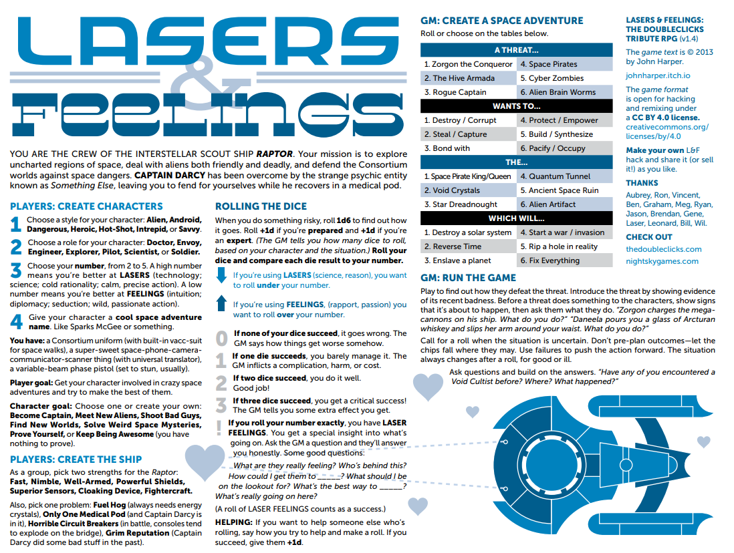
Why make a one-page TTRPG?
Share experiences and explore new ideas.
Raise awareness of a specific topic.
A design thinking exercise
Core mechanic + core experience or theme or vibe.
Lasers and Feelings
http://www.onesevendesign.com/laserfeelings
Notes:
<nina>
But why even make a one-page TTRPG?
<click> In general, RPGs are outlets for people to share experiences and explore new ideas, <click> or raise awareness of a specific topic.
Creating them is also a <click> design thinking exercise, requiring us to consider what we want to put into the game, what our audience wants from the game, and what can truly fit on one single page.
And lastly, <click> one-page RPGs specifically tend to focuses on one core mechanic and experience. This makes them unique from other RPGs which could have a handful, a dozen, or an uncountable number of mechanics. Imagine playing a game where you roll a die just to see if something succeeded and check it against a stat of your enemy, then another die to see how much damage you do, and you roll several other dice given specific scenarios (like if you have Inspiration with a capital I). Now consider <click> Lasers and Feelings, a onepage RPG that spoofs the classic sci-fi genre, mixing Star Trek, Star Wars, Doctor Who, and truly any other science or fiction that players want to bring to the game.
On this dense but singular page, they explain <click> character set up, in which players only have one stat to worry about, <click>
how to set up your silly Star Trek parody ship, <click>
a loose rule about making decisions, <click>
and some fun optional randomization for the story. <click>
There’s somehow even space for suggestions for the Game Master and a drawing of a space ship with some links.
This is all GMs need—and all your players need–to play this game. This is what we’re aspiring to today, and you’ll each leave with a solid foundation of an idea or at least the process to create your own one page RPG.

Slide 5
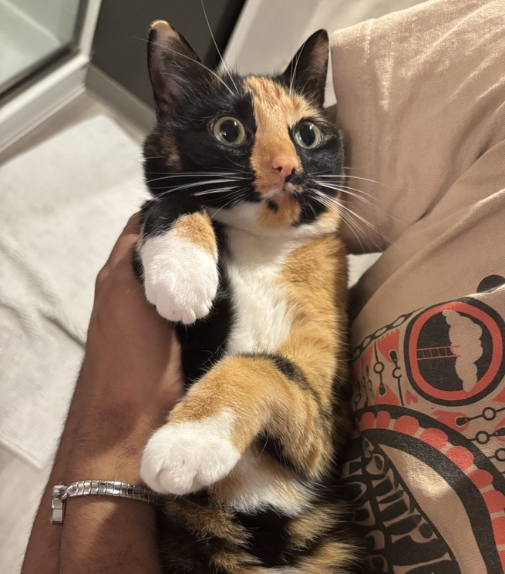
Empathize + Define: Game Foundations
Topic: Brainstorm and select one topic for your RPG
What do you want the game to look like to the player(s)?
Inspirations: What can you borrow from media/games related to this topic?
What other games have you played and what were their rules?
Theme: How can you build "game feel" / vibes?
What are some "actions" that people do related to that topic?
What do players do a lot? How does the world change the player?
Game mechanics/rules will determine the outcome of actions
My cat & inspiration for my game, Figueroth
Notes:
Deepti
So now that we know what we're building today, we can start making our RPGs by empathizing with our game's potential players and defining aspects of our game based on what we want our players to experience.
<CLICK> The first step is to brainstorm and research a few general topics you could turn into a game. These topics can be based on anything, you can make a game based on a genre, movies or TV shows you've seen, personal experiences like road tripping or doing your morning routine, or even a random Wikipedia article! Once you have a few ideas, pick your favorite topic that you’ll base your game on. For this presentation, we'll be running through the example with <CLICK> Cats
Now that you have a topic, <CLICK> you should think about what other external media you could use to inspire elements of your game. You can research existing references that are related to your topic, games that had engaging rules or mechanics, or even draw from your personal experience with your topic.
For example, if I was making a Cat RPG, I could be inspired by my own cat’s behaviors at home, as well as video games like Stray where you roam around the city as a cat, and even unrelated games like Chutes and Ladders and Dungeons and Dragons because I like its rules.
Once you have a few inspirations <CLICK> you can use them to generate Theme words to describe the vibes of your game. How would you want a player to describe the world of your game? What sort of creatures or things exist in your inspirations, and could any of them be in your game’s world?
As you write down these descriptors, think about the ways you could illustrate your game’s themes to your players. If the game is supposed to be scary, how can you raise the stakes for the players? If it’s a silly game, how can players get silly?
For my Cat RPG, I'd want the game to have a chaotic and silly vibe, and I could say that cats in my game can be vocal, clumsy, spicy, etc. Or that they love yarn and tight spaces (based on my cat's own preferences for these things).
<CLICK> Once you have a sense of your game’s themes, you can start writing down common “actions” that characters could do to interact with the world or actions that could happen to them. Look back at your Inspirations and Themes and see if there’s any character-world interactions that happen frequently. What should players expect to be able to do or encounter as they play your game so that they feel the themes you wrote down earlier?
These actions are going to help us make our games’ rules and mechanics because in your game, the outcome of these actions will likely be determined by the game mechanics you create. In the Cat RPG, for example, I might want my players to embrace cats’ chaotic natures, so they might expect to be able to explore small spaces, hide from scary noises, interact with other animals/humans, be generally chaotic, etc.
With these actions in mind, I’d want to think about how players can determine whether their actions succeed or fail and how I can make these actions feel chaotic in gameplay (which we’ll go more into detail later).
(Slide gives instructions and tips on how to fill out Part 1 of the worksheet, and what to think about as they fill it out)
Deleted content:
What is unique about those "actions"?
How could you portray that "unique-ness" into a game, like a "game mechanic"?
How can those "actions" be illustrated in gameplay, to help players really experience what it’s like to do those things?
These actions are going to serve as the basis for our game’s mechanics which will help us determine the outcome of , so as you’re writing them down start thinking about ways that they can be illustrated in gameplay
fleshing out what our game should look like from the players' perspective.

Slide 6
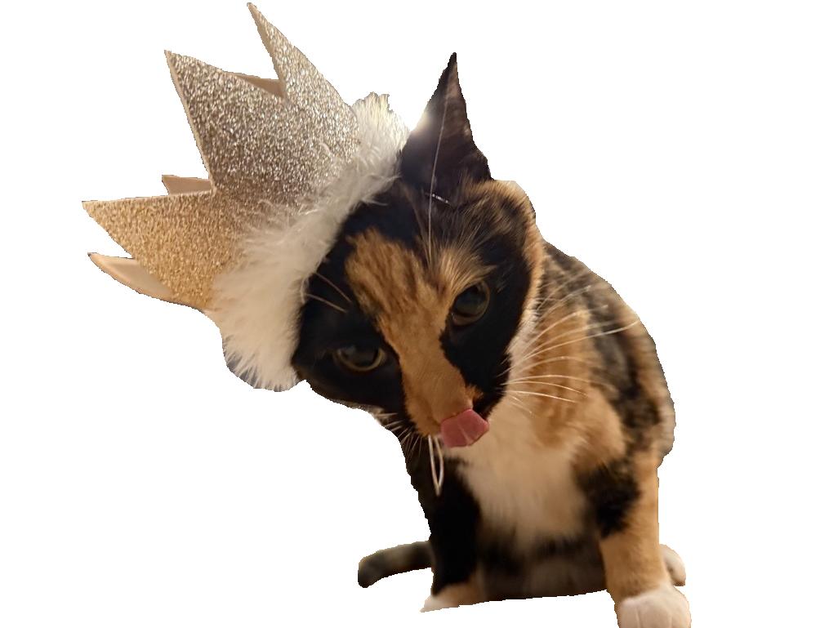

Workshop: empathize & define
PART 1
10 MINUTES
FIELD | DESCRIPTION | EXAMPLES
Topic | What your game will be about | Genres, movies/TV shows, video games, personal experiences, … (Cats)
Inspirations | Media that’s related to your topic and games + their mechanics that you’ve liked | For “Cats,” video game Stray, my cat Fig, Dungeons and Dragons, Chutes and Ladders, …
Themes | Descriptors for what your players would see/feel in your world | For “Cats,” chaotic, silly, lots of cats, maybe other animals, running around a city, …
Actions | Ways your players can interact with the world and vice versa | For “Cats,” players could explore small spaces, knock things over, … Players could also encounter scary dogs that chase them, animal control, other humans that try to pet them, etc.
Feel free to move on to other sections as you brainstorm
Nothing needs to be perfect!
Worksheets & slides here: tinyurl.com/CreateYourOwnOnePageRPG
Notes:
Deepti
So now we’re going to take about 10 minutes to fill out Part 1 of the worksheet, where you’ll be doing some topic generation and light research so that once you pick your RPG topic you can fill out your Inspirations, Themes, and Actions. A few notes before you get started:
This is a brainstorming phase so don’t edit yourself just yet!
Put every idea on the page even if you’re not sure if you’ll use it, and feel free to update other sections in this part as you think of new things.
Most importantly, we’re only building a first draft today so NOTHING HAS TO BE PERFECT! Focus on getting something workable on the page, if you need help or have any question we’ll be walking around in-person and monitoring the chat for virtual participants!
IF YOU WANT TO SEE A FULLY FILLED OUT WORKSHEET EXAMPLE, you can find one at our tinyurl in the “worksheets” section. I filled out the worksheets to make my “Cats in the City” game.
This workshop time will be about 10 minutes to fill out Part 1 of the worksheet,
the goal of this section is to brainstorm without filter so that they have plenty of ideas to choose from in the next sections
We'll also provide an example worksheet that we've filled out to give them a sense of what it might look like

Slide 7
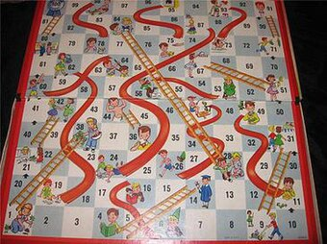


Ideate: turn actions into gameplay
Mechanics are rules and parts of a game “that govern and guide the player's actions, as well as the game's response to them.” (Wikipedia)
What backgrounds can players have to make them feel special?
Customization is key (within reason)
Focus on attributes players can pick that help build a backstory
Snakes and ladders - Wikipedia
Notes:
<nina>
You’ve brainstormed some actions, now let’s turn those into gameplay.
The core of any RPG, or any game really, is it’s “mechanics”. <click> The “Mechanics” of a game are the rules and parts of a game that govern and guide the player’s actions, and also how the game responds to those actions.
When players make a decision, mechanics help determine the outcome. For example, in the simple board game Snakes and Ladders, there’s only one decision for players to make, without a choice: roll the dice. Since the goal is to get to the top of the board, the only way to do so is by rolling and moving that many spaces. But the mechanics of the snakes and ladders determines how that action goes–if you roll a 4, <click> then you go up the board, to simulate climbing a ladder, from space number 4 to space number 14.
On your next turn, if you roll a two, <click> you’ll slide right down the snake to space number 6. In this way, Snakes and Ladders pretends you’re really climbing and sliding, even if you’re playing on a flat board.
But this is a relatively simple game. How could we level this up into an RPG? Currently in the game snakes and ladders, every player is exactly the same. Rolling the same dice, moving along the board the same. But imagine that you could create your own character for Snakes and ladders-- <click> we could consider what might make players feel special. And how can those quirks impact the mechanic of climbing ladders and sliding down snakes?
Maybe a character has a background in climbing ladders, so they actually get to climb one extra row--but they’ll also slide down any slides they land on, even if it’s midway through the slide. Maybe another character is particularly sticky, and thus resistant to slides– maybe they only slide half the distance of the slide, but they can also only climb half the distance of the ladder.
These choices not only help people build the backstories of their characters and interact with the gameworld in interesting ways, but they also directly impact the mechanics of the game. With just a simple change of customization for players, we can make the simple game of climbing and sliding into an epic storytelling game about a party of heroes trying to withstand the trials and tribulations of a cursed forest full of.. Snakes and ladders.

Slide 8

Actions → Mechanics
Fighting
Swinging a sword
Casting a spell
Throwing your fists
Actions
Things that impact swinging a sword
Strength
Type of weapon
Enemy armor
Mechanics
Attributes
Weapon stats
Armor class
Notes:
<nina>
Soon you’ll get 15 minutes to work on turning your own actions into mechanics. In order to do that, take a look at your actions. What is an action that needs an outcome, and can have some randomness?
Let’s take a look at Dungeons and Dragons 5e. One of the main actions you can do is fight. What are all the things that go into fighting? <click> What are the actions? <click>
Well, for starters you might be swinging a sword, casting a spell, or throwing your fists. Let’s pick swinging a sword: to figure out the outcome that action, you’d need to know <click> the things impacting that action. <click> So how strong are you? What type of weapon are you swinging? And how strong is the enemy’s armor?
Each of these things contributes to <click> the mechanic of fighting– <click> and in D&D 5e they’re known as attributes, weapon stats, and armor class respectively. This is just one part of the larger system of D&D 5e—you can see how work like this scales into massive RPGs and huge tomes of books.
But for today, we’re looking to write just a one page RPG. So perhaps a one-page RPG variant would not get so detailed as include the type of weapon and the weapon stat, or you could simplify enemy armor to just rolling against the amount of health an enemy has.

Slide 9
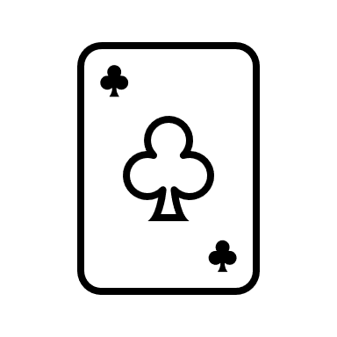
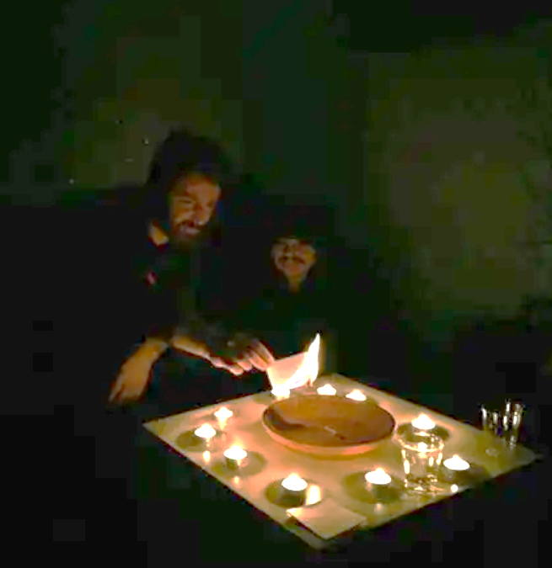
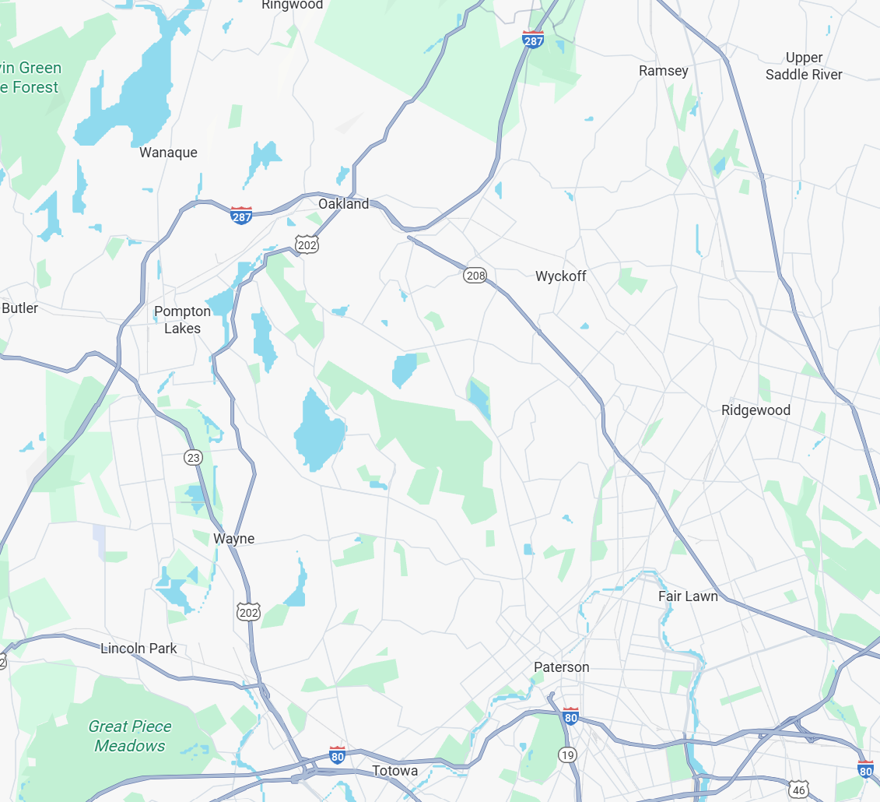
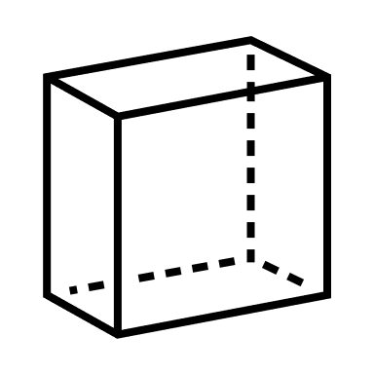


Tools of chance
Is there randomness involved?
What information helps determine the outcome?
Ten Candles — Cavalry Games
Notes:
<nina>
So when you’re considering the actions you want to turn into a mechanic, ask yourself: <click>
What information helps determine the outcome? and
Is there randomness involved?
Keep in mind that randomness doesn’t have to be dice. There are plenty of other tools of chance. In a game aptly named 10 Candles, <click> literal candles determine some of the outcomes. When a candle blows out, the game ends, regardless of whether someone blew the candle out on purpose, by accident, or if it was the wind.
In a game I made called “Road Trippin”, <click> real-world maps are the game maps. Players literally visit the road side attractions and restrooms on their way to a destination of their choosing, and the length of the game determines the length of the road trip in miles.
Games also use things like <click> decks of cards, Jenga towers, stopwatches, and silent bidding to add interesting randomness to the game. Consider the game “The Quiet Year” where you work with other players to tell the story of a village. The story plot points are randomized with a deck of cards– you draw a card and the suit of that card correlates to the season you’re in, while the value tells you what kind of event happens to the village.
Or in another game I made, called “Do you copy?”, players only have 15 minutes to tell a story. Utilizing timers and stopwatches, the number in the last position of the stopwatch when you make a decision is the number you’ve rolled. So you can wait longer to verbally make a decision to sway the outcome, but in doing so you’re losing some of the previous 15 minutes.
The best one-page RPGs use thematic, immersive ways to determine outcomes. Maybe the mechanics aren’t as practical for long campaigns where players could learn to cheat the system or get tired of the activity, but for a one-shot game, it’s more than enough.

Slide 10
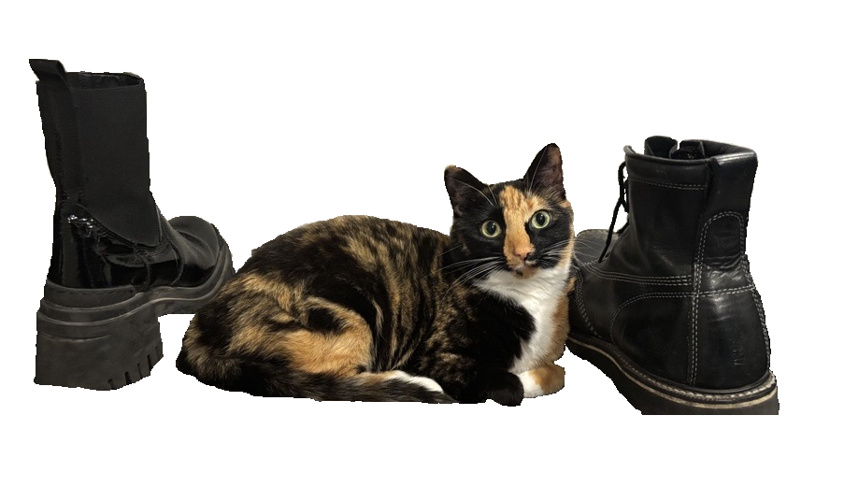

Workshop: Ideate
PART 2
15 MINUTES
GAME | ACTION / IDEA | MECHANIC
Cats in the City | Cats are chaotic and sometimes do crazy things that hurt them, but also help them | A “chaos roll” can help or hurt the cat, and they don’t know when it’s going to happen
Road Trippin’ | On a road trip and you have to hold in pee, getting increasingly desperate for a bathroom | A “pee meter” that goes up periodically, which makes other rolls worse
Astronomers | Discover planets no one has ever seen before and observe their attributes | Compare a card from a deck to a table: e.g. all “7s” are considered “extremely hot” planets.
Do you copy? | A limited amount of time to talk to a planet across the galaxy | The number on a timer counting down when a decision is made is the number that’s “rolled”
10 Candles | Telling a scary story at night, that is still slightly hopeful, but always in the brink of disaster | When literal, actual candles on the table are blown out, players lose something important regardless of how it was blown out.
What info helps determine outcomes? Is randomness involved?
Worksheets & slides here: tinyurl.com/CreateYourOwnOnePageRPG
Notes:
<nina>
And on this slide, we’ve got some more sample mechanics here. In Cats in the City, there’s a chaos mechanic to simulate the chaos of real cats. The DM can ask them to roll a die which may hurt or help them.
In Road Trippin, players must also manage a pee meter, which gets higher the longer they go without visiting a rest stop or stopping at the side of the road, and eventually starts to hinder their gameplay.
In Astronomers, players discover planets which are represented by cards from a standard 52-card deck. The suit and value determines the size and attributes of the planet, and where the card is physically placed on the table represents its location in the universe.
In Do You Copy, players only have 15 minutes to talk to someone on the other side of the galaxy, and use a countdown timer to determine what number has been “Rolled” instead of dice.
And finally in 10 candles, real candles are used to move the story forward—whether they were blown out on purpose or not. This adds inherent tension as players try to keep candles alive even as they burn down the wick.
All right, before we let you into the workshop time, remember you can always reference a filled out worksheet at our tinyurl in the “worksheets” section.
Ok, you have 15 minutes starting now.
---
Here are some more examples of actions that were turned into mechanics—
In Deepti’s Cat’s in the City, the chaos of cats are represented by a random “chaos roll” that the Dungeon Master can ask for at any time. This roll can hurt—or even help– the cat.
Full disclosure, I made the next three games, but in Road Trippin, you’re on a road trip and you have to hold in pee. So on your character sheet, there’s a pee meter which goes up over time and subsequently makes your rolls worse until you go pee.
In Astronomers, to discover a new planet in the solar system, you draw a card and the suit and number of the card compares to a table to tell you the attributes.
In Do you copy?, you have a limited amount of time to talk to another planet in the galaxy, so there’s always a countdown timer going during the game. But When you need to make a decision, you look at the “Seconds” on the stopwatch and that’s the number you’ve rolled.
Finally, in Cavalry Games’ 10 candles, it’s a scary story so to keep the ambiance, you light literally 10 candles. Then if any of them get blown out for any reason—wind, someone laughing, or on purpose– the game shifts and something is lost.

Slide 11
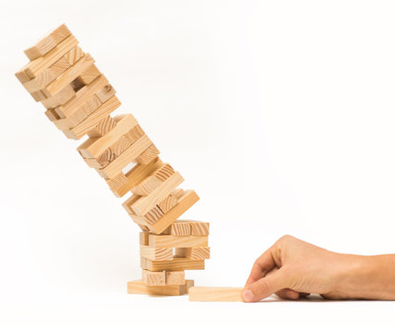
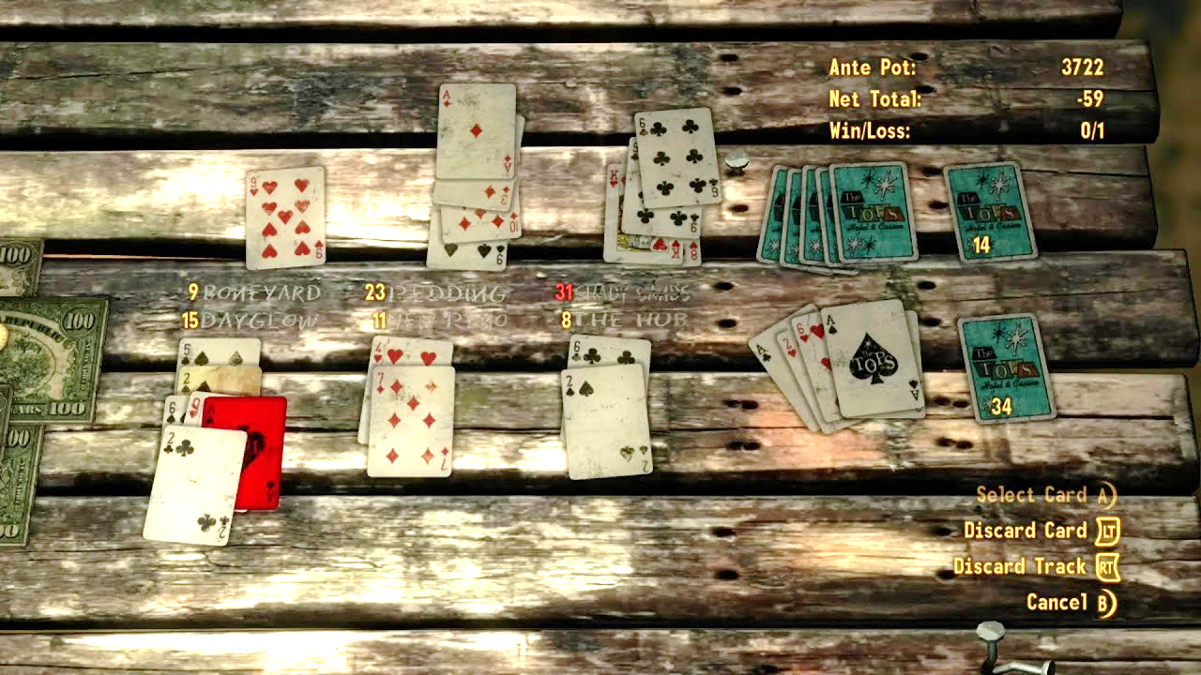

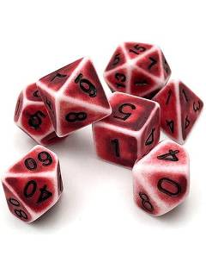
Prototype: Writing the rules
Start simple, refine later
"If I had more time, I would’ve written a shorter letter"
Aim for info-rich, easy to explain
What's your game’s core idea?
What's your core mechanic?
Let players fill in the gaps
Does this rule add to immersion?
Screenshot from Fallout: New Vegas, Xbox
Notes:
Deepti
We’re finally at the point in the workshop where you’ll take all your brainstorming and synthesize it into a neat one-page roleplaying game. <CLICK> Though a lot of our content would help you design something larger, today we're talking about a one-page ruleset for, potentially, a narrow set of scenarios or settings or purposes. So start simple, and then after today you can use playtesting to continue to develop your ideas and refine your game (which we’ll talk about later).
<CLICK> We can take a page (pun intended) from 18th century philosopher Blaise Pascal when he said "If I had more time, I would have written a shorter letter." Think of a time like Pascal's when wordsmithing and crafting a message involved relatively expensive inks and paper and candlelight and quills made of feathers or reeds. We're not just talking about time but the resources it took to craft, iterate, and edit a message. The wisdom here is that with careful time and attention, we *can* communicate better with fewer words.
These days, we are unbound by resources like ink and paper and feathers. If we're in a hurry, we'll find ourselves writing in loops, going on disorganized tangents, or focusing less about the core topic. So if you end up with a two or three-page RPG today, or even a board game, that's ok, maybe after some playtesting and wordsmithing, you'll end up with a sleek, information-rich, easy to explain, one-page RPG.
<click>When you’re developing a prototype of your RPG, you should craft a quick pitch on what your game is about, aka it’s “core idea”. You can borrow from your work in the first part to describe your game's setting, who the players might be within this setting, and what character's in this world might expect.
Is this a tidy little game about being crew members on a ship, like in Lasers & Feelings? Or a micro RPG about being an astronomer, or on a road trip, or being cats in the big city? Defining this core idea not only helps your players learn about your game, but also acts as a guiding star as you create the rest of your prototype.
<click> When you have your core idea, you can start synthesizing all of your game mechanics so that you have a core mechanics. As much as I love having niche rules and binders of spells for unique scenarios, for our one-page RPG we should keep mechanics simple and leave the rest to the rule of cool!
Even for larger TTRPG systems like D&D, you can still explain it's core mechanic pretty simply (roll a d20, higher the better. There’s a number to beat. That’s it.)
Your core mechanic can unify multiple rules and should be the main mechanic your players use to interact with your world. For instance, in my Cats in the City RPG, the core mechanic is that you roll some number of D6 depending on how good you are at a skill, and if the sum of your roll beats the Cat Master’s number, then you succeed on your action!
<click>A little tip: Let the players fill in the gaps where your game’s rules or mechanics are undefined.
Sparse rules are a feature of one-page RPGs, not a fault, so you should embrace that ambiguity which allows for the rule of cool! In any storytelling game, the Game Master should have an attitude that we should try to make cool stuff happen, even if it bends the rules.
<click>Once you have your core mechanic, you can add a few other rules that help build the game's immersion. The mechanics that your players' use to interact with your world don't have to be completely separate from the roleplay, if anything these mechanics should emphasize the themes you want to be present in your game!
There is a roleplaying game named Dread, a horror setting where tangible anxiety is built by the core decision mechanic, <CLICK>a physical game of Jenga.
As the Jenga tower gets more precarious, tension rises at the table and in the game. If the Jenga tower falls, bad stuff happens. In Dread, your game’s physical presence on the table, or the items used to play it, or the communication requirements or limitations, could all contribute to the immersion
<click>For Cats in the City, I want to emphasize how chaotic and crazy cats can be, so I said the GM can ask the players to roll a "Chaos Die" if they think the player's actions are particularly unhinged. Depending on whether the Chaos Die lands on evens or odds, that number can be added or subtracted from the player's original roll, making it either wildly succeed or hilariously fail!
After today, to continue developing your idea, you can use play testing to simplify and unify the rules, sift out extraneous details, and tighten your pitch. Only include rules for what is necessary and important.
I can explain the core mechanic of the Free League Year Zero system to you right now - roll a bunch of six-sided dice and count the 6s. If you roll just one 6, and you succeed. Done. That's it. No math. Brilliant system. Each game in the Year Zero system, which are big systems with big books, has little twists and modifications, but the basic mechanic is that. A pile of d6s, count the sixes. (And sometimes the 1s.)
How many of you played Caravan, the card game inside of Fallout: New Vegas? One of the core mechanics of the game is that you are using cards from a standard 52-card playing deck, but only those cards you've found scattered around the wasteland. That mechanic is so clever, integrating the junky chaos of the wasteland into the game itself.
We're not trying to explain a euro style board game here. For example, I've got a hundred bucks that you can't explain how to set up and play Settlers of Catan: Cities & Knights, with all its counters and stacks, to a group of friends in less than 15 minutes. Keep the rules concise.
For another example, in the immersive roleplaying game Alice is Missing, all the players must solve the mystery of a missing teenager by communicating only via texting. Typed text only. The game is silent. Talk about immersion!

Slide 12




Mechanics/Rules Tips
CREATE YOUR OWN RPG
Limited number
Aim for a single mechanic that is easy to teach.
Easy to calculate
Use one form of comparison: counting, summing, etc.
Keep it Simple, Silly!
Content can be fun to write, but is it necessary?
Notes:
Deepti
Before you start copying and pasting every idea you've written down into your prototype, consider the following.
<Click> Limit the number of mechanics in your one-page RPG. Consider a few mechanics, and try to wrap your system around two, or maybe just one. Are two mechanics similar? Combine them. Is a rule more clever than immersive? Maybe cut it. And of course, your rules should embrace the rule of cool!
In dungeons and dragons 5e there are rules and different formulas for broad jumping vs long jumping, with or without a running start. But for one-page RPGs like cats in the city RPG we don't need long vs short jump mechanics, but maybe just 4 skills like sneak, explore, attack, or charm that you roll more dice for depending on how good you are at said skills!
<click>Next, if you have multiple mechanics, and that's ok if you do, avoid mixing different types of comparisons or logical operators. For example, if your game includes players assigning a number to a stat and then rolling over that number, that should be the only way to roll a die and check it against a number in the game.
Do not include another mechanic where you have to roll under, or do additional math, counting vs summing, etc. Try to settle on just one probability scheme, so that players can at least easily know what a good die roll looks like. It doesn’t have to be higher or lower. It doesn’t even have to be dice. But it should at least be concise.
<click>And last but not least, Keep it simple silly! Consider the content you want to write, that you enjoy to write, vs the content needed to play a game.
As much as I'd love to dive into the mechanical differences of various cat toys or create monster stat blocks for dogs, animal catchers, and vet technicians, my Cats in the City RPG doesn't really need that on the off chance that players encounter those creatures.
Instead, I could divert that energy into creating optional encounter tables so that GMs can roll for what the story is, for example "helping a dog out of a dumpster" or "doing a prison break from the vet's office".
Like I mentioned in the previous slide, leaving things undefined in our rules allows our players to fill in the gaps with their own creativity in-game!
Ok, with all that said, let’s get to building the prototype of your RPG in our next workshop period!
Say what you wanted about D&D 4th edition, I will entertain your D&D4e slander, but most character classes played exactly the same. Everyone had a standard move minor, every round of combat, every class had the same way to track the scarcity of abilities. It was **easy to teach**. Take that one virtue of D&D4e as an example.
I playtested an RPG that contained a dozen pages of starship components and modules, just in case the players found themselves in the unusual position of buying an expensive starship. The author really wanted to explore what starships could look like and create lots of options. I get it. Space ships are rad. Massive tables of inventory, loot, and stats for them, are fun to build, but not necessary to run a one-page RPG game!

Slide 13

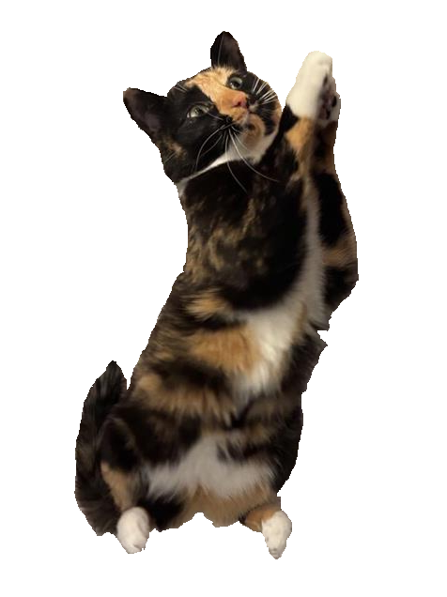
Workshop: Prototype
PART 3 (BOTH SIDES)
15 MINUTES
Describe your game and its core mechanic
Define how the game starts, what happens on a player's turn, the game’s loop, etc.
Tips:
Use your work in Part 1 and 2 to fill out these sections
Consider adding quick ways to make an adventure, like providing example adventures or tables to randomly generate a story
Worksheets & slides here: tinyurl.com/CreateYourOwnOnePageRPG
Notes:
Deepti
Here where you get to dive into the mechanic, the game’s loop, etc.

Slide 14
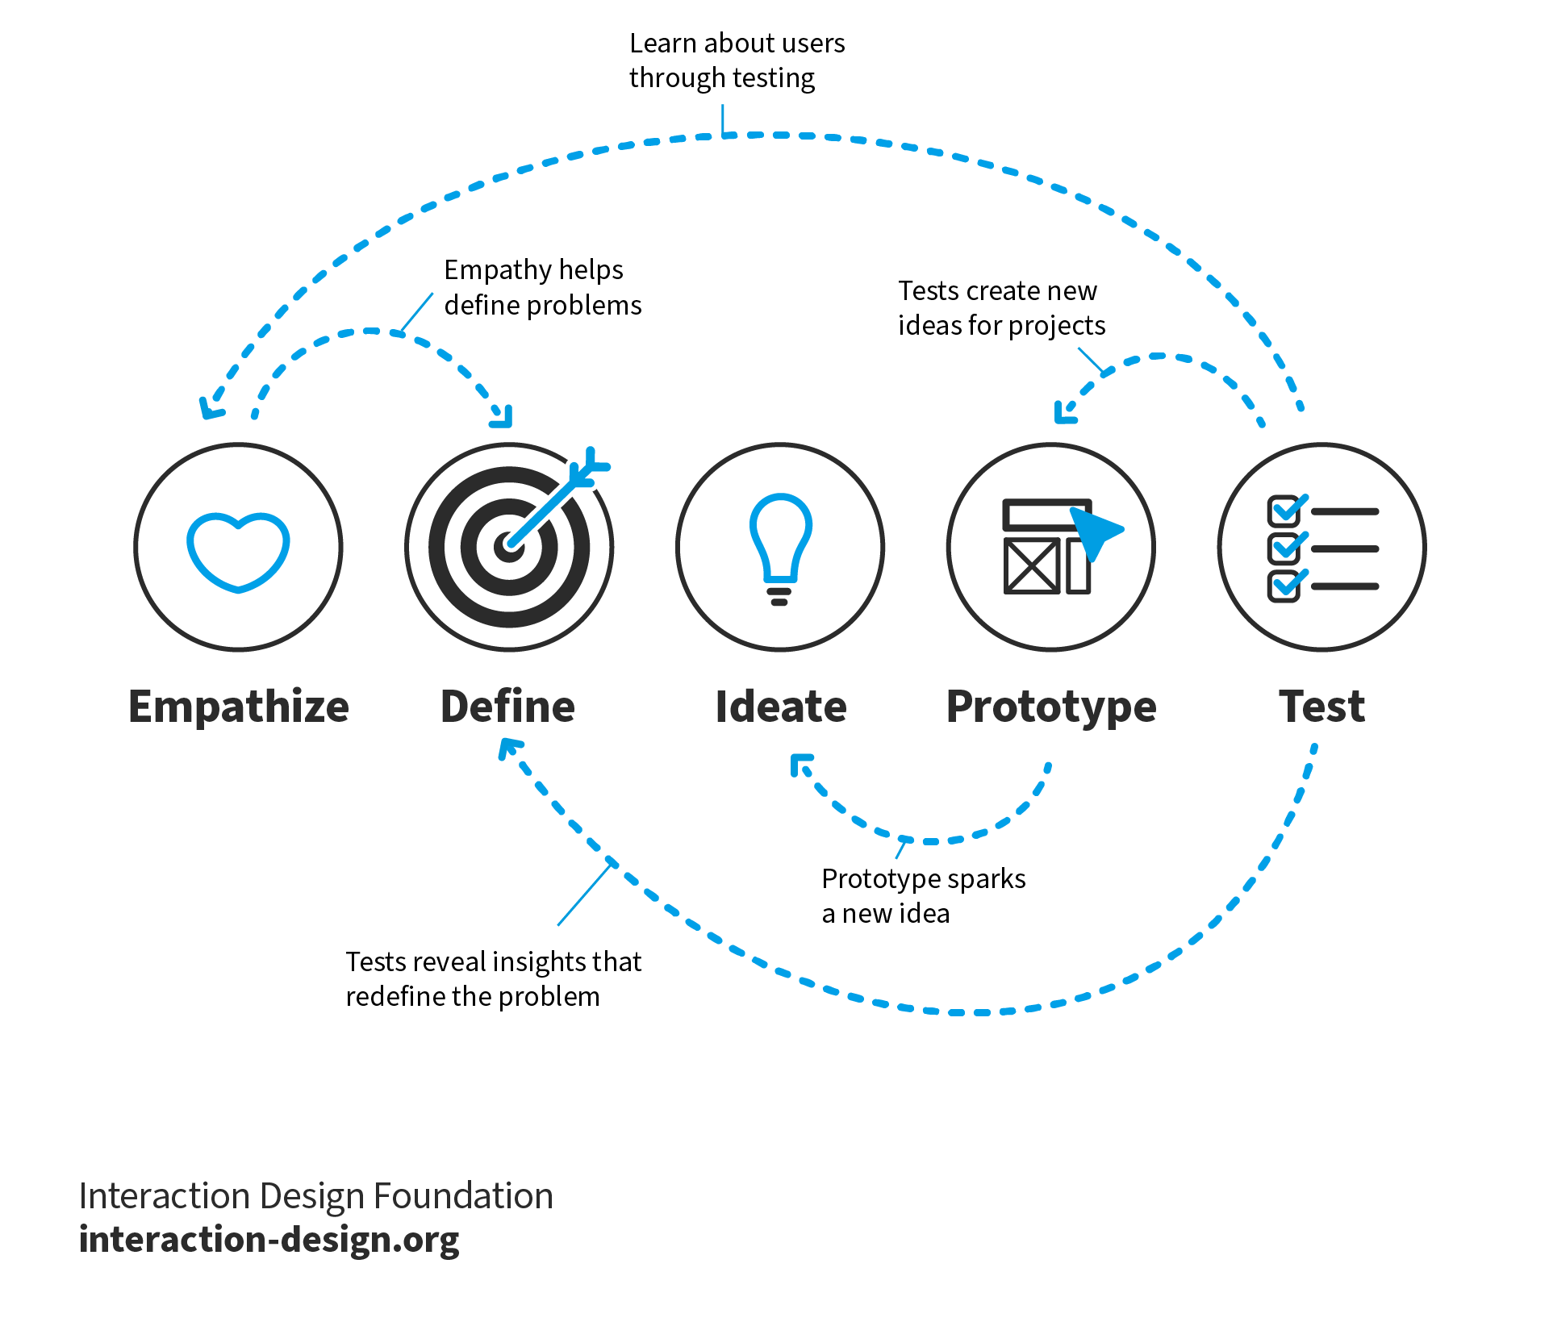
Design thinking
“Design Thinking is a discipline that used the designer’s sensibility and methods to match people’s needs to what is technologically possible and a viable business strategy to convert into customer value and market opportunity.” – Tim Brown
Design thinking is a way to create anything, work on any project, in a way that is human-centered at its core and favors progress over perfection
Notes:
deepti
It might not have felt like it as you were making the game, but everyone here just used Design Thinking to make an RPG!
<CLICK> Design thinking was originally adapted for business purposes by the design consultancy IDEO and its founder Tim Brown. <CLICK>They used it as a way to understand business needs and challenges and find solutions to problems in a way that’s human-centered at its core and favors progress over perfection. ​The trick in design thinking is to get into the shoes of the customer, to understand what they want and empathize with them in every step of the design process.
<CLICK> It allows us to build robust solutions by having us iterate through multiple stages of <CLICK> empathizing with our audience, <CLICK>defining our problem space, <CLICK>generating ideas for solutions, <CLICK>prototyping the best ideas, <CLICK> and testing these prototypes to gather feedback that we can integrate into our next iteration. Frequently development in one stage can lead to updates in any or all stages regardless of order, <CLICK> and the design thinking framework encourages us to bounce between these stages regardless of order so that we can maintain creative freedom while keeping our ideas organized.
We tie all the work we've done to abstract design thinking principles.
Emphasize that Design Thinking is an iterative process, we've only helped them with the first iteration of their game but they can repeat these steps to improve their game
This is why we emphasized that nothing needs to be perfect, Design Thinking favors progress over perfection

Slide 15
Design thinking
What you did:
Empathize – you thought about a topic, and considered your game mechanics from the player’s POV
Define and Ideate – you thought about the fun in the game and defined the rules.
Prototype – you wrote a playable draft of your game's rules
What's next:
Test – you can test your prototype by having someone else play your game and give feedback on what worked and what didn't
Iterate – you can repeat this process to integrate feedback into new drafts of your game
The 5 Stages in the Design Thinking Process | IxDF (interaction-design.org)
Notes:
deepti
When you think about what we did while creating the game, <CLICK> we started out by picking a topic and empathizing with our “audience” (aka the players of our game) so that we could describe what they should be able to do and/or experience while playing the game.
<CLICK> Once we had a sense of what we wanted our game to look like, we defined game mechanics that would help our players experience the events that occur in our game and how we could build the “fun” in the game.
<CLICK> Finally, we wrote a prototype (or playable draft) of the game’s rules!
<CLICK> We’ve only produced the first draft of your game in the workshop, so the next steps for your game would be to <CLICK> test it by having someone else play your game and give feedback, and then <CLICK> repeating this process to integrate that feedback into future drafts of your game! I’ll also note that especially for one-page RPGs, iteration doesn’t always mean adding more rules or making things more complicated. For every iteration you should remind yourself of what the ultimate goal of your game should be, and depending on that it might make more sense to broaden definitions or provide less content so that your players can fill in the gaps themselves. Nina tell us more about next steps for your game
We tie all the work we've done to abstract design thinking principles.
Emphasize that Design Thinking is an iterative process, we've only helped them with the first iteration of their game but they can repeat these steps to improve their game
This is why we emphasized that nothing needs to be perfect, Design Thinking favors progress over perfection

Slide 16
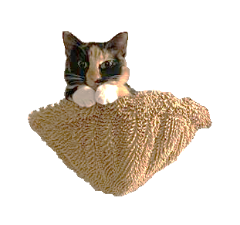

What to do with your game
Playtesting
Observe silently (without playing)
Everything’s up to interpretation
Ask them to think out loud
Publishing
DMs Guild, DrivethruRPG, Roll20
Itch.io
GitHub, your own personal website
Notes:
<nina>
And now that each of you has an amazing RPG on your hands, what will you do next?
The first thing you should consider is playtesting <click>. Once you've got a version of the game you're happy with, gather a group of friends (or even some people a conference) to playtest your game. You should observe other people playing your game, without you playing with them or participating. <click> Take silent notes, and don't talk to the players while they're playing. And this is mainly so you can see how people will interpret what you wrote. You can adjust your wording afterwards so it's closer to what you want people to read, but <click> roleplaying games are generally up to interpretation. Some people may even come up with amazing ideas you didn't think about! You should also <click> encourage people to think out loud. If someone seems confused about something, or wants to try and bend the rules, ask them to explain their ideas. But remember that you’re not supposed to answer them during the playtest! Instead, they should pose the question to the other players, or if it's a single-player game, they can try to resolve the question on their own. After you've playtested, you might consider <click> publishing your game. Site like the DMs Guild, Drivethru RPG, and Roll20 are open marketplaces specifically for RPGs where you could put up your game for others to find, play, and even pay you. Similarly, <click> Itch.io is a website that is commonly known as an indie video game platform, but it also hosts a significant amount of RPGs, and there are frequent onepage RPG jams you can participate in. But when you use any marketplace, I recommend you read up on their policies before setting up shop so you understand how they function. Finally, you can always host your game on Github as a free Github Page, or on your own personal website.
Regardless of where and how you publish, your game should be accessible, payment should be simple (if you’re looking to get paid), and players should know where to find more of your games.

Slide 17
Thanks | Q&A
Download slides here: tinyurl.com/CreateYourOwnOnePageRPG
RPG from the talk | Why it was mentioned
Dungeons & Dragons | Common TTRPG people know; played in Stranger Things and Big Bang Theory
Lasers & Feelings | Well designed one-page RPG
Cats in the City | RPG created by Deepti using this workshop’s format; includes “chaos” mechanic
Ten Candles | “Candle” mechanic where real, lit candles impact gameplay
The Quiet Year | No Game Master, and players can make decisions that cause “grudges”
Everybody’s John | Bidding mechanic to “gain control” of the story
Road Trippin’ | “Pee meter” that impacts game play (designed by nina)
Astronomers | Drawing cards to simulate discovering planets (designed by nina)
Alice is Missing | Completely silent; No game master; players must text each other
Dread | Horror style game where a game of Jenga is used for tension
Caravan | Junk-based card game inside Fallout: New Vegas where you can only play cards you find
Notes:
<nina>
And that’s all we’ve got for you! We’ll leave you with a list of all the games we talked about during this talk, and if anyone has any questions we're more than happy to answer them. We hope that you’re inspired to continue working on this game, play it with your friends, and continue design thinking throughout your day.
If you see us in the freeplay room this weekend feel free to stop over and say hello! Thanks for your time and happy gaming!

Slide 18
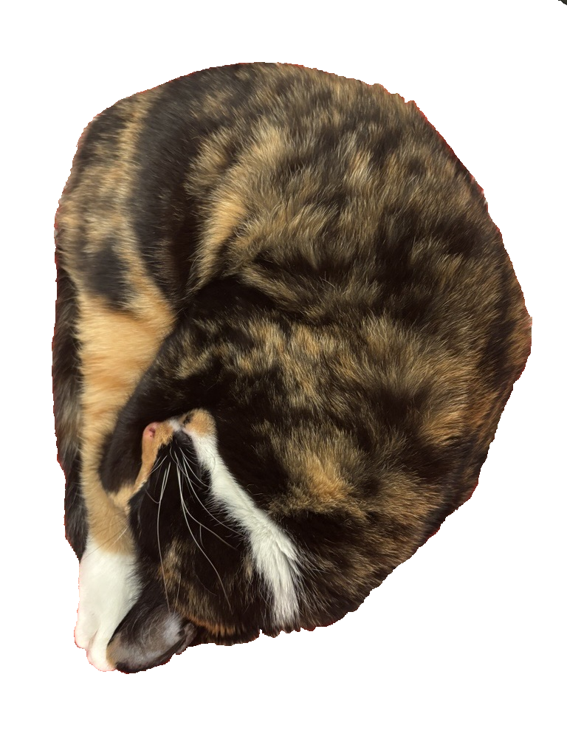
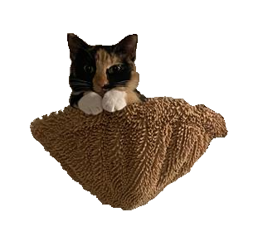
Cat/Fig Pics

